Slide 1
Tuesday
1
31.03.2020

Slide 2
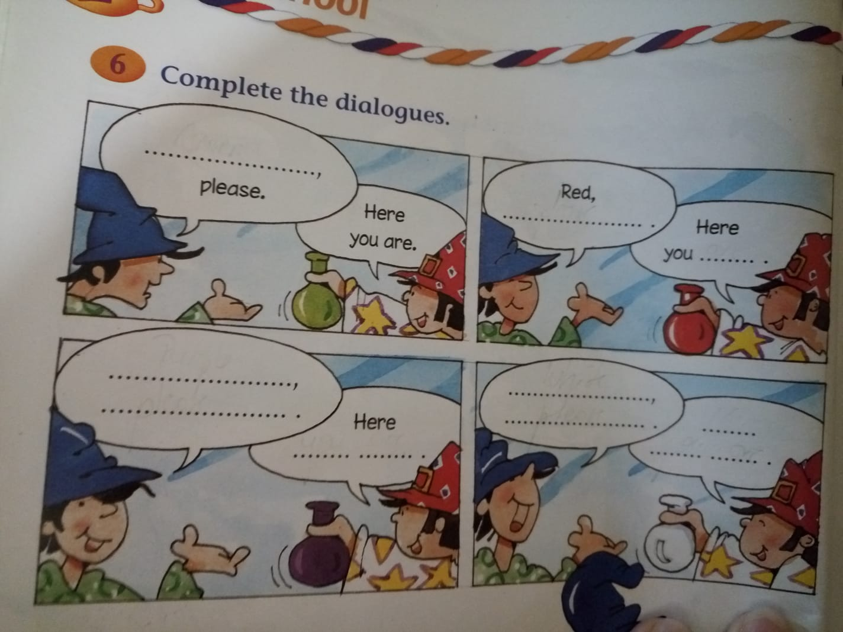
1. Complete the dialogues.

Slide 3
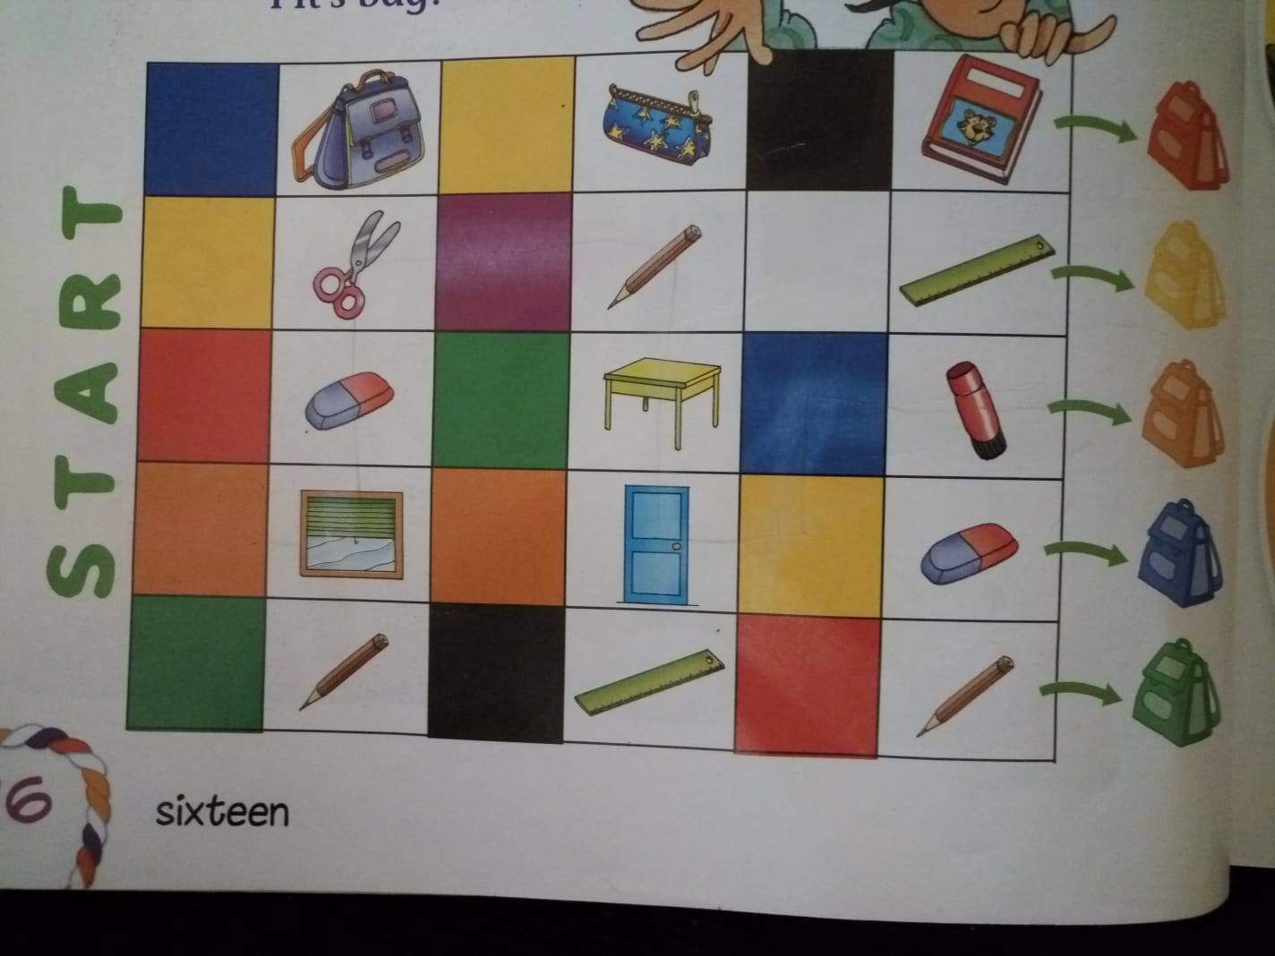
2. What colour is Pit’s bag? orange, window, rubber, scissors, purple, pencil, table, door, yellow, blue, glue.

Slide 4
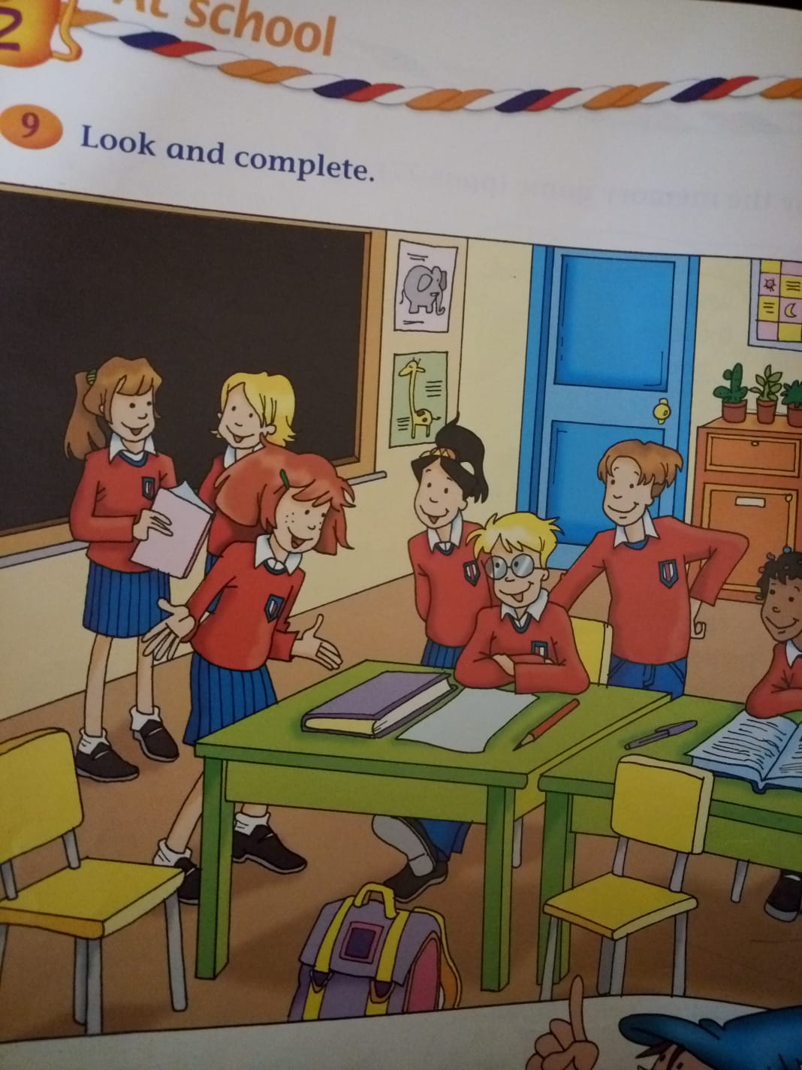
3. Look and complete.

Slide 5
The cupboards are orange.
The door is blue.
The board ….. ………………. .
The desks …… ……………….. .
The …………… .............. yellow.
The …………… ……………. brown.

